Slide 1

Operating Systems 2-7029110
Lecture 5 - Scheduler
Ariel University Computer Science Department
Notes:
http://pubs.opengroup.org/onlinepubs/009695399/functions/xsh_chap02_04.html

Slide 2
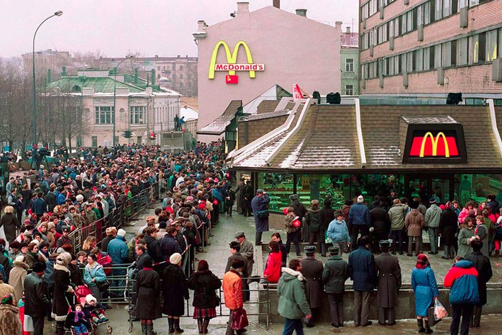
Why Scheduler
https://www.kasparov.ru/material.php?id=5E401D09B8AF0
Notes:
Open, close, duplicate
Handling signals
When are signals processed
Signals handlers

Slide 3
The Scheduling problem
We want all the jobs to be done, but we want all of them to be done NOW.
So we need somehow preoritise the jobs ,taking into consideration system needs. Relative goal – utilise full system power
Notes:
Open, close, duplicate
Handling signals
When are signals processed
Signals handlers

Slide 4
CPU bound vs I/O bound
CPU bound – a process that has hight need in computing power (blockchain)
I/O bound – a process with low need for CPU, generaly this processes has an I/O interaction (uncompressed audio)
Notes:
Open, close, duplicate
Handling signals
When are signals processed
Signals handlers

Slide 5
OS types in Scheduler view
Batch: non interactive system. Used in banks, insurance companies, Super Markets.
Interactive: Multipurpose. Web Servers, PC, mobile OS
Real-Time: ROS, smart watch,autonomus car
Notes:
Open, close, duplicate
Handling signals
When are signals processed
Signals handlers

Slide 6
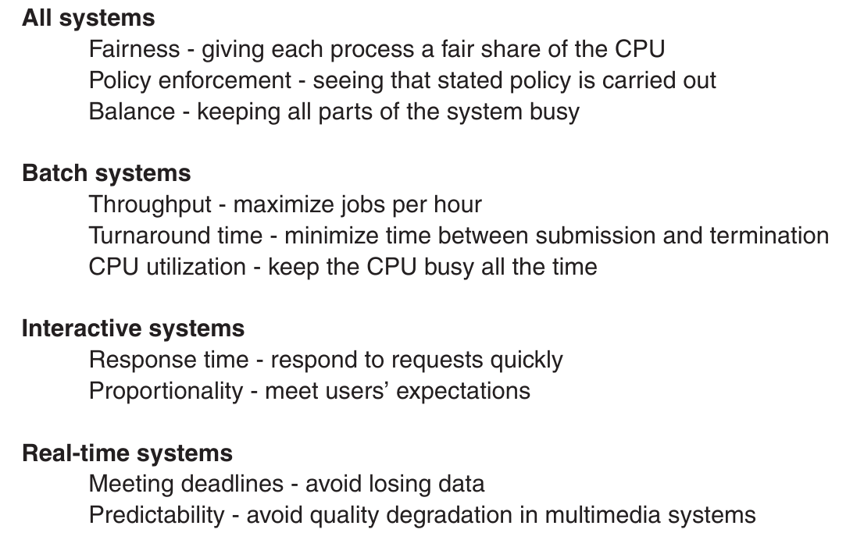
Scheduler Goals
Course Book.
page 154
Notes:
Open, close, duplicate
Handling signals
When are signals processed
Signals handlers

Slide 7
Scheduler aproach
When should we switch to another process ? Non preemtive – By Event: exif, fork, I/O, Mutex, nice (?) Preemtive - By Time: only when clock tiks (if exist)
Both of them ? Genral approach for all ?
Notes:
Open, close, duplicate
Handling signals
When are signals processed
Signals handlers

Slide 8
Scheduler Algorithms
First-come, First-served (FCFS):
Non-preemtive
Fair in manner of waiting time
Good for batch systems
No efficient at I/O
Notes:
Open, close, duplicate
Handling signals
When are signals processed
Signals handlers

Slide 9
Scheduler Algorithms
Shortest Job First(SJF):
Non-preemtive
Minimise turnaround time
Length of job should be knows in advance
All jobs should be available on start,to be effective
Notes:
Open, close, duplicate
Handling signals
When are signals processed
Signals handlers

Slide 10
Scheduler Algorithms
Shortest Remaining Time First(SRTF):
Preemtive
Minimise turnaround time
Remaining time of job should be known
Notes:
Open, close, duplicate
Handling signals
When are signals processed
Signals handlers

Slide 11
Scheduler Algorithms
Highest Response Ratio Next (HRRN):
Non - Preemtive
Tries to avoid the drawback of Shortest Job First by taking into account the waiting as follows
Notes:
Open, close, duplicate
Handling signals
When are signals processed
Signals handlers

Slide 12
Scheduler Algorithms
Round Robin:
Preemtive
Fair in manner of resource division between jobs
Long time slices vs Short time slices (Quantum)
All jobs have same priority
Notes:
Open, close, duplicate
Handling signals
When are signals processed
Signals handlers

Slide 13
Scheduler Algorithms
Priority scheduling:
Preemtive or Non Preemtive
Fixed priority
Priority by Type (I/O vs CPU)
Dynamic priority (1/f, all up, running down)
Notes:
Open, close, duplicate
Handling signals
When are signals processed
Signals handlers

Slide 14
Scheduler Algorithms
Advanced scheduling:
Priority queue (fixed)
Priority queue (duble quanta)
Guaranted Scheduling (1/ # processes)
Lottery Scheduling
Owner Fairness
Notes:
Open, close, duplicate
Handling signals
When are signals processed
Signals handlers

Slide 15
Scheduler Algorithms
A word about Real time systems
Hard vs Soft real time
Periodic vs Aperiodic
Is it schedulable ?
Static algo (aka fixed) vs Dynamic
Notes:
Open, close, duplicate
Handling signals
When are signals processed
Signals handlers

Slide 16
Scheduler Algorithms
A word about Threads
User level vs Kernel level
Thread in the same process – effective context switch
Thread pool with dispatcher structure
Notes:
Open, close, duplicate
Handling signals
When are signals processed
Signals handlers

